Slide 1
“I know that you believe that you understand what you think I said, but I’m not sure that you realize that what you heard is not what I meant.”
Richard Nixon, thirty-seventh president of the United States

Slide 2
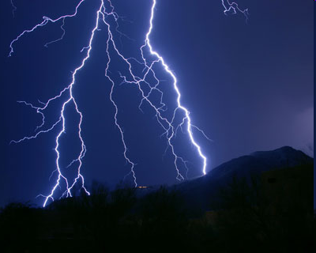
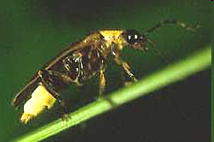
Mark Twain once said that the difference between the right word and the almost-right word is the difference between…
lightning
…and the lightning bug.

Slide 3
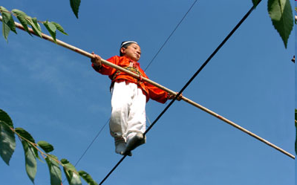
Effective Language
Effective Oral Communication
Accuracy and economy of language
Figures of speech to make effective imagery
Sound devices to make music
What is the connection between a tightrope walker and effective use of language?

Slide 4
Effective Language
From a High School English teacher:
“If communication is not effective, then students are left confused, and the educator has wasted the students’ time.”
“People judge you by your ability to express yourself.”

Slide 5
Accuracy of Language
Concrete
Take me out to the ball game
Take me out with the crowd
Buy me some peanuts and Crackerjack
I don’t care if we never get back

Slide 6
Denotation and Connotation
Denotation – dictionary definition
Connotation – meaning of a word that goes beyond the dictionary definition – it is the meaning we associate with the word.
What is the connotation of the word “mother”?
“I think that women can make excellent contributions to any job and should be paid the same as men. Women shouldn’t be limited to simply being mothers!”

Slide 7
Say what you mean!
Simplify
Simplify
Simplify
On page 344, read excerpt from Thoreau’s speech
Watch out for language barriers!!
“Ich bin ein Berliner.”
“Pepsi brings back your dead ancestors.”

Slide 8
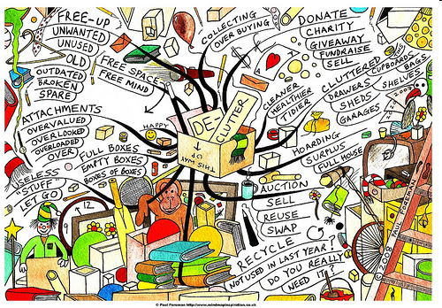
Say what you mean!
If spoken language becomes long and involved, the listener can get lost.
WORDS can get in the way and clutter up the message. The average person has a vocabulary of 10,000 Words.
Avoid:
unnecessary prepositional words
too many clauses
repeating the same idea

Slide 9
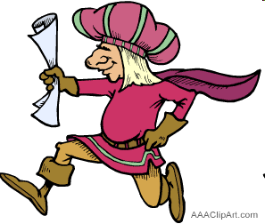
Before Twitter, before email, before the postal service, and before the pony express:
Messengers would delivery messages using rhyme and colorful descriptive language.
Why do you think they did this?
Picturesque language was more memorable!
If Helen Keller had a choice, she would choose hearing over seeing. If language was used effectively, it would allow her to “see” in her imagination.

Slide 10
Figures of Speech
Use comparison imagery!
“Education is the key that unlocks many of life’s opportunities.”
“A high school diploma is the key that will give you the potential to unlock many occupational doors later in life.”
Besides using “key,” what other metaphors can emphasize the value of education?

Slide 11
Figures of Speech
Use comparison imagery!
Read Robert W. Goodman’s quote in response to his son’s death on pg. 347.
When he says “Grief belongs to the nation,” what comparison is made and why is it a meaningful metaphor?
Effective language involves CREATIVE comparisons that stick with your audience. If the comparison doesn’t stick, the language wasn’t effective.

Slide 12
Figures of Speech
Use Contrast Imagery
Antithesis – balancing one against another
“It doesn’t matter whether you are young or old, experienced or inexperienced, rich or poor, you can make a difference in this organization.”
Oxymoron – jolts listeners and demands they think and pay attention
“Because I always fall gracefully, friends say I have athletic clumsiness.”
Irony – opposite of expectation

Slide 13
Figures of Speech
Exaggeration
Francis Bacon, a 17th century philosopher said that “the only people who should be forgiven for exaggeration are those in love.”
Is there an exaggeration here?
Listen to me read Communicating in the Real World on pg. 350-351.
Was the exaggeration helpful or harmful?
Don’t exaggerate to the point that no one believes or trusts you.
Use it only to enhance.

Slide 14
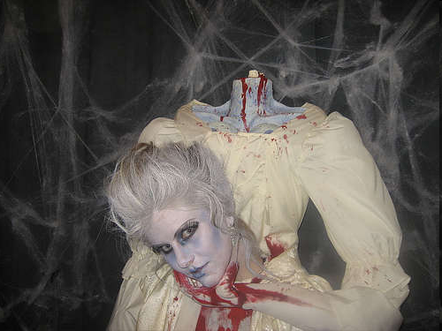
Figures of Speech
Exaggeration
Hyperbole:
I laughed my head off!

Slide 15
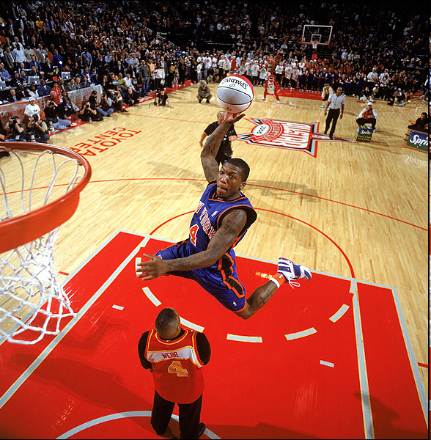
Figures of Speech
Exaggeration
Understatement:
The winner of the basketball Slam Dunk competition can jump a little.

Slide 16
Figures of Speech
Exaggeration
Personification:
Don’t allow dishonesty to sneak up on you.

Slide 17
Make Language Sing
Repetition – make music with words
By repeating individual sounds
By repeating words or group of words
Alliteration – gives special significance to the specific language you choose to speak
Assonance and Consonance – repeated sounds or vowels and consonants in groups of words

Slide 18
Make Language Sing
Excerpt from Ben Franklin’s letter:
“Mr. President, I doubt…whether any other convention…may be able to make a better constitution; for, you assemble a number of men, [with] all their prejudices, their passions, their errors of opinion… . From such an assembly can a perfect production be expected? It therefore astonishes me, Sir, to find this system approaching so near to perfect as it does. …
Thus I consent, Sir, to this Constitution, because I expect no better, and because I am not sure that it is not the best.”

Slide 19
Make Language Sing
Parallel Structure – involves repetition
“Treat your car with respect. Your car will take care of you only when you take care of your car.”
Parallel Structure reinforces an idea or series of ideas. Plus! It adds musical effect!
Like father, like son.
Easy come, easy go.
He came, he saw, and he conquered.
Read the Gettysburg Address on page 354.

Slide 20
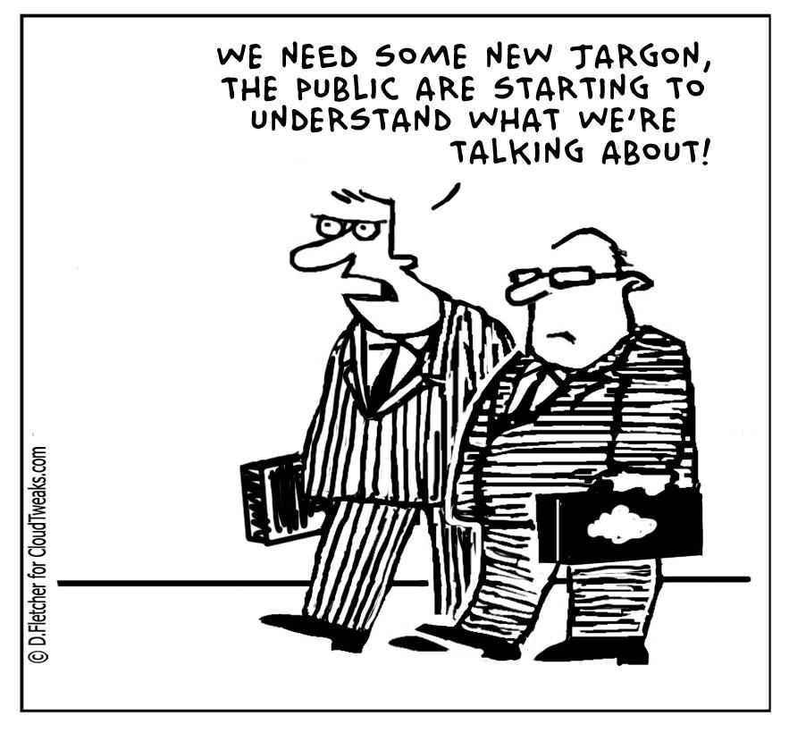
Language to avoid
Jargon –
specialized
language

Slide 21
Language to avoid
Sexist Language
Spoken language must show that you believe that both sexes possess and can demonstrate equal abilities and talents and that gender has no relevance to a person’s worth.

Slide 22
Language to avoid
Double Speak
Euphemisms often avoid truth, lack depth, and are more evasive than helpful.
Ex: “Armed Situation” instead of war.
What are some euphemisms for killing?
For death?

Slide 23
Language to avoid
Avoid shocking or obscene language
Sometimes, people do this to try to appeal to an audience by using “street language.” It can be shocking to an audience not expecting it.
It can turn most people off.

Slide 24
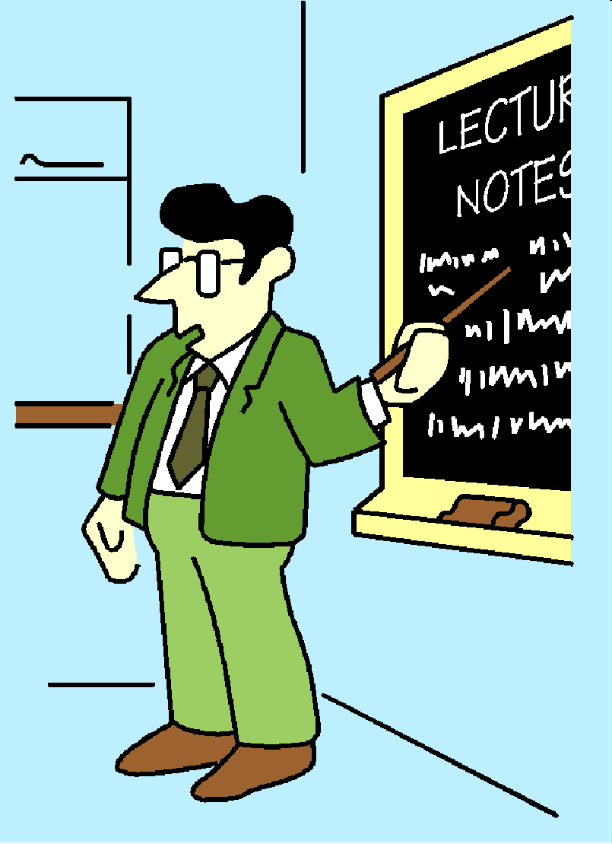
Language to avoid
Avoid shocking or obscene language
Ex: A teacher is lecturing.
…And accidentally spills their coffee/water on their shirt.

Slide 25
Language to avoid
Avoid shocking or obscene language
“!@#$”
How do you think the class will react?
Is a curse word worth the price?
Is vulgarity ever worth the sacrifice of effective verbal communication?

